Slide 1

Climate Change: Prediction of Future Temperature

Slide 2
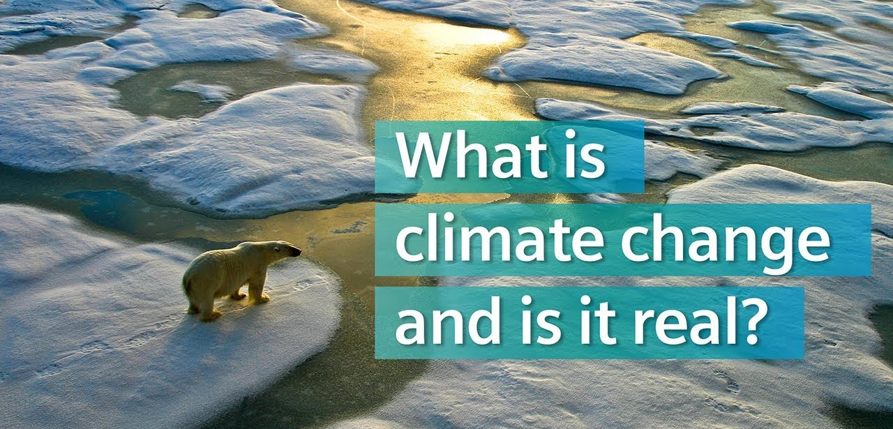

Slide 3
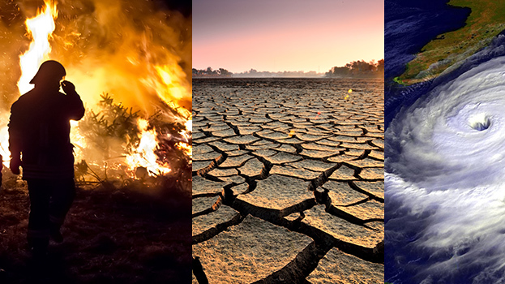
The Effect of Climate Change

Slide 4
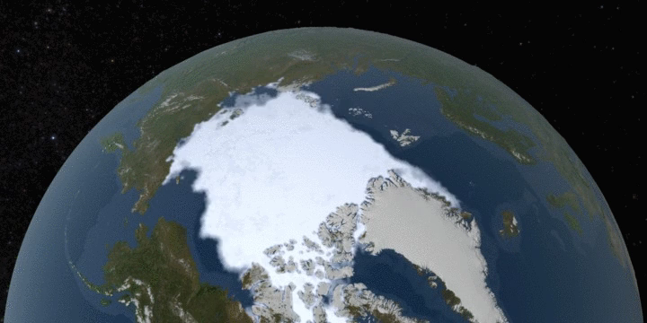
Satellite observations for Antartica from 1979 to 2018

Slide 5
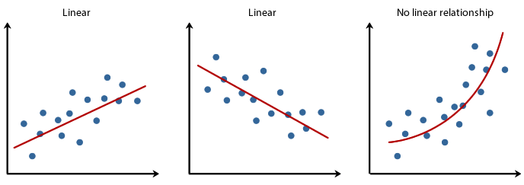
Methods Which We Used
1)Linear Regression
2)Polynomial Regression

Slide 6
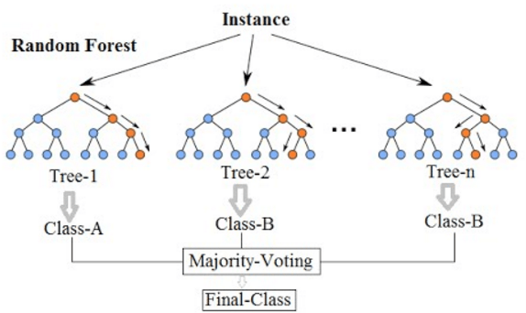
3)Random Forest

Slide 7

4) Neural Network

Slide 8

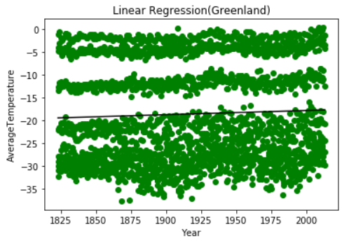
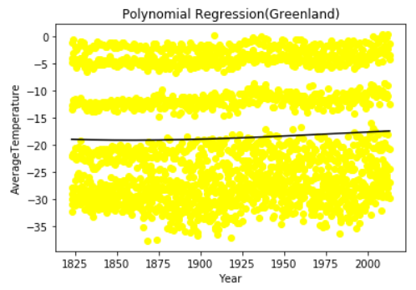
Average Temperature in 1800 = -19.67
Average Temperature in 2019 = -17.65
Prediction of Average Temperature in 2100 = -16.91
Average Temperature in 1800 = -18.98
Average Temperature in 2019 = -17.20
Prediction of Average Temperature in 2100 = -15

Slide 9

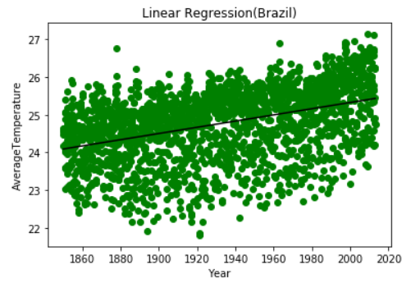
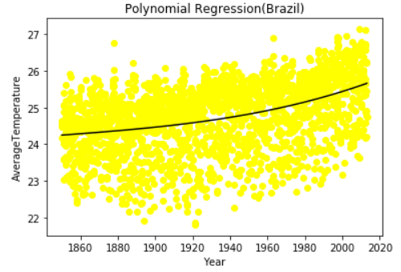
Average Temperature in 1800 = 23.68
Average Temperature in 2019 = 25.48
Prediction of Average Temperature in 2100 = 26.14
Average Temperature in 1800 = 24.33
Average Temperature in 2019 = 25.71
Prediction of Average Temperature in 2100 = 27.28

Slide 10
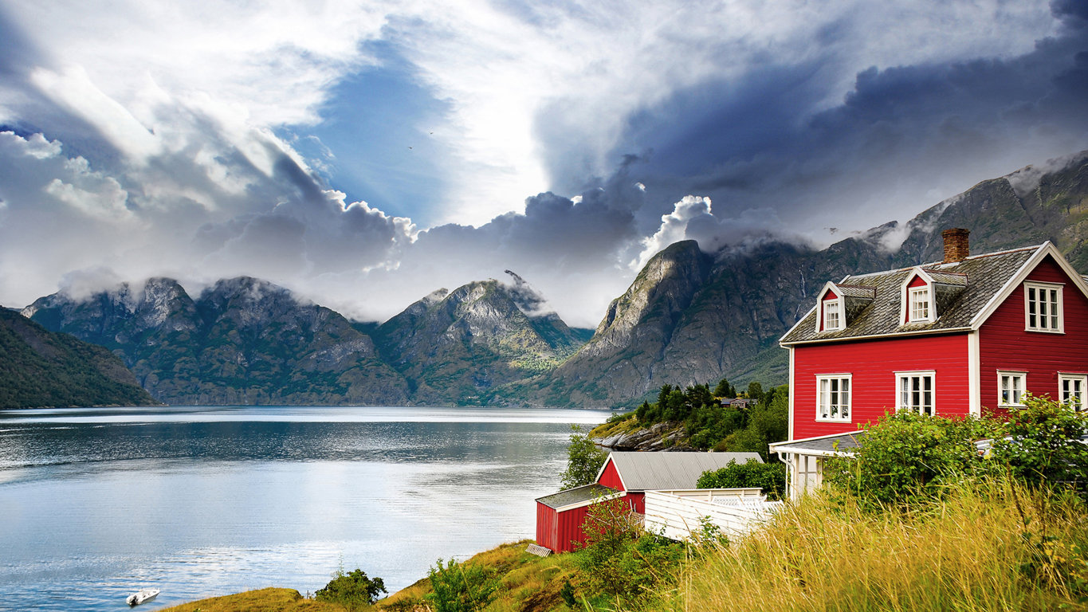
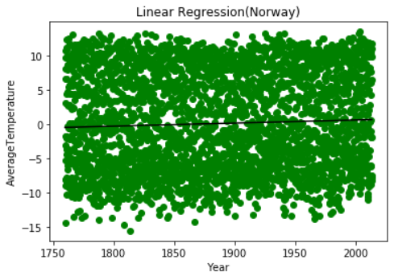
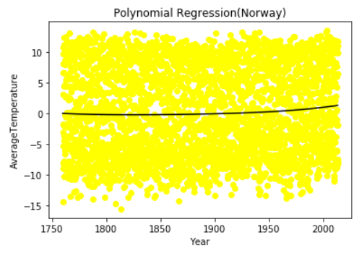
Average Temperature in 1800 = -0.18
Average Temperature in 2019 = 1.25
Prediction of Average Temperature in 2100 = 2.87
Average Temperature in 1800 = -0.27
Average Temperature in 2019 = 0.70
Prediction of Average Temperature in 2100 = 1.06

Slide 11
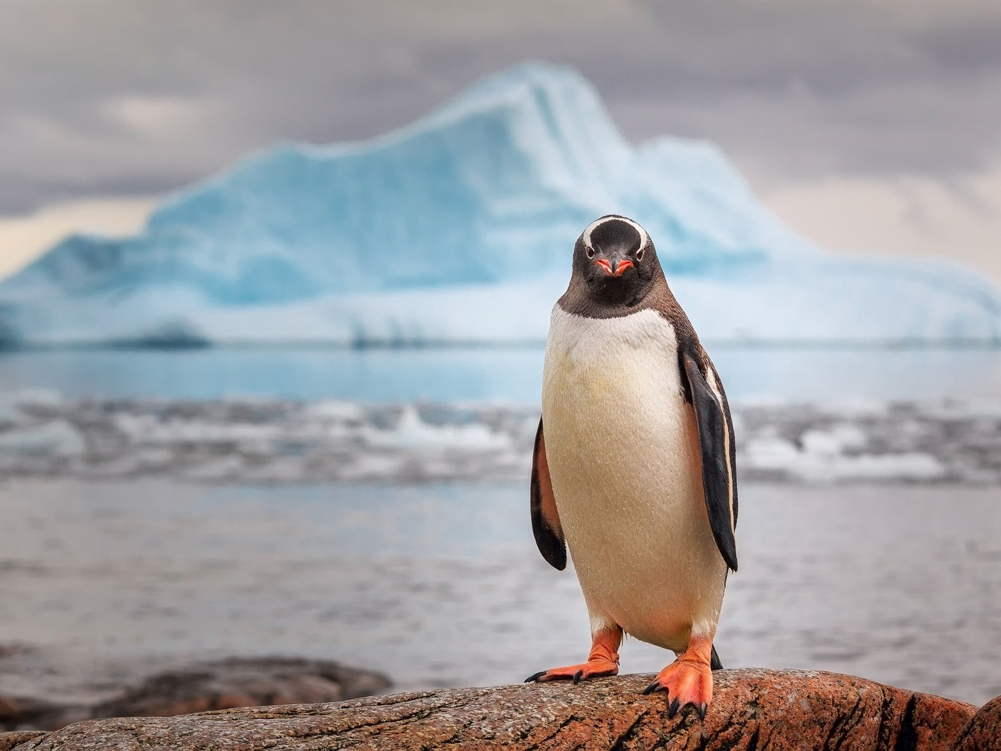
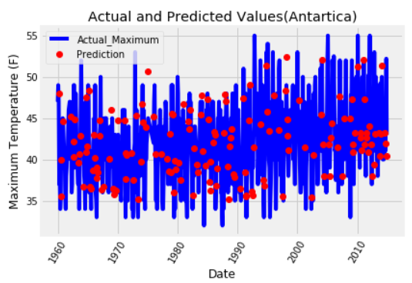
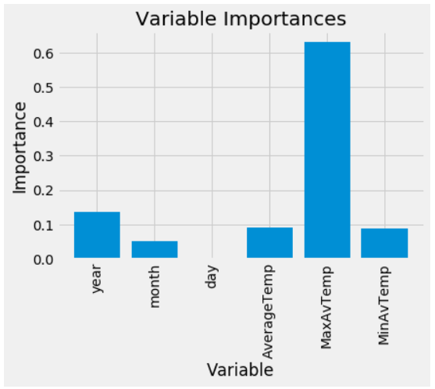
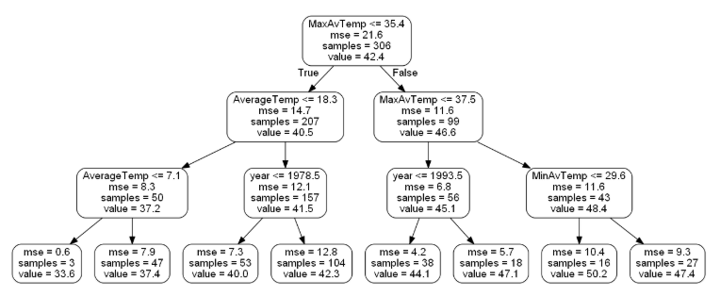
Accuracy = 95.01%
Mean Absolute Error = 2.08 degrees

Slide 12

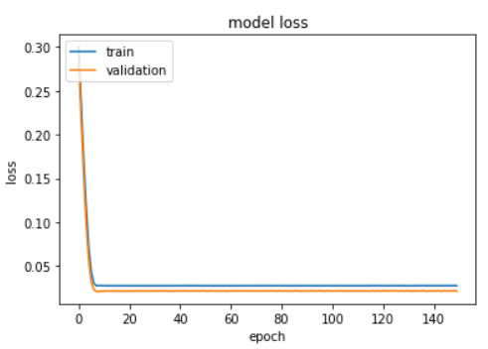
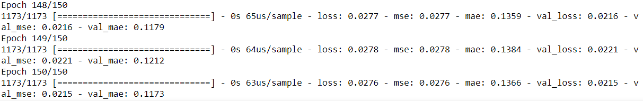
Average Temperature in 1800 = 23.68
Average Temperature in 2019 = 25.48
Prediction of Average Temperature in 2100 = 26.14

Slide 13
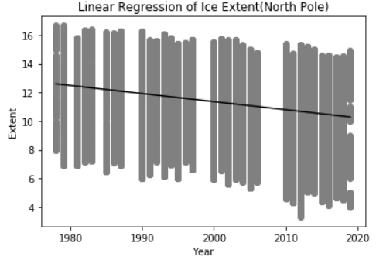
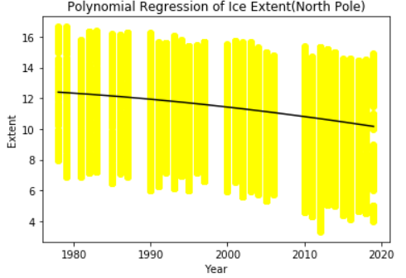
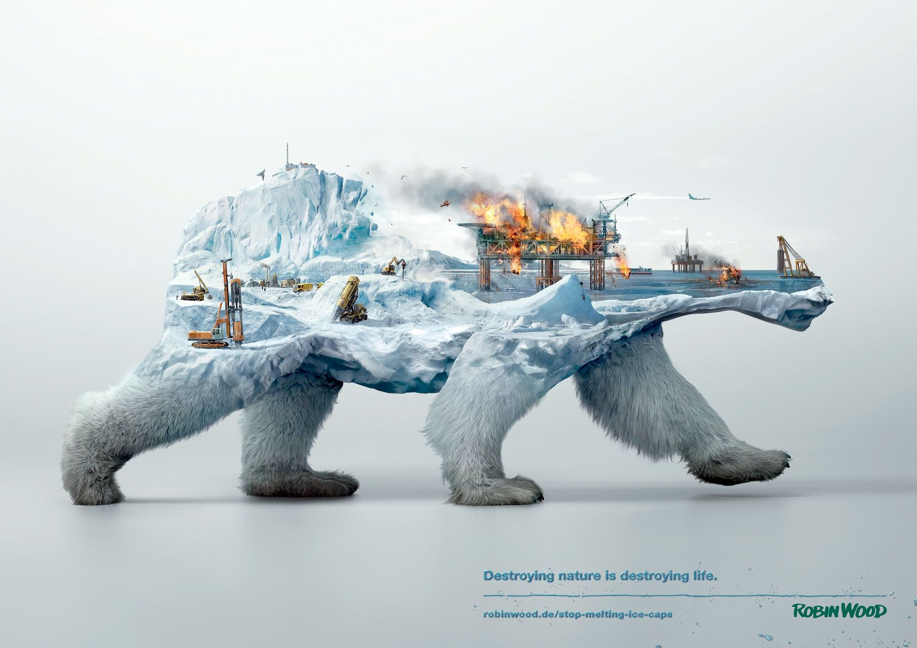
Ice extent in 1950 = 14.17*10^6
Ice extent in 2019 = 10.28*10^6
Prediction of ice extent in 2100 = 5.70*10^6
Ice extent in 1950 = 12.76*10^6
Ice extent in 2019 = 10.16*10^6
Prediction of ice extent in 2100 = 1.39*10^6

Slide 14
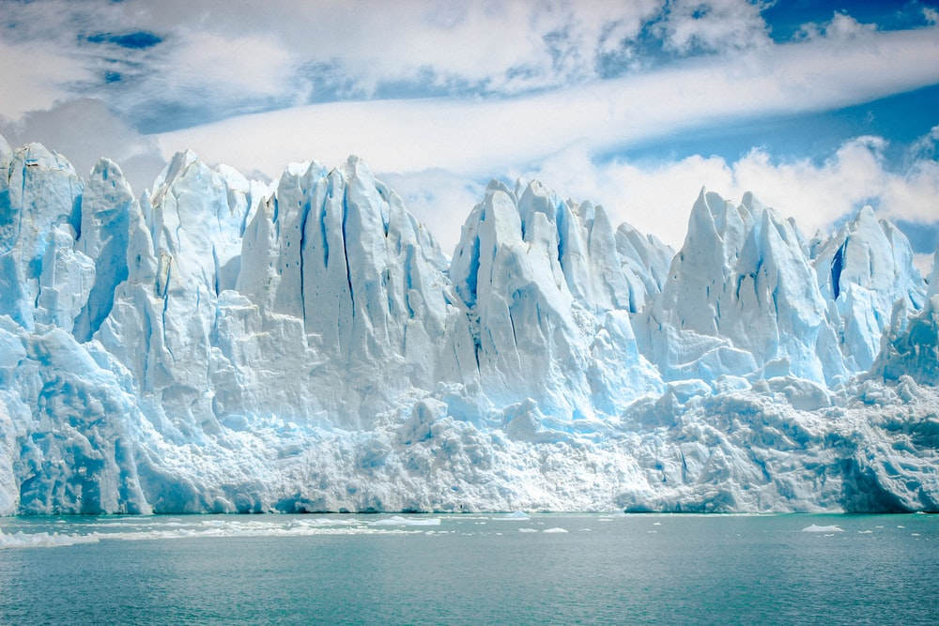
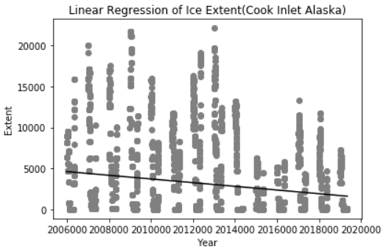

Slide 15
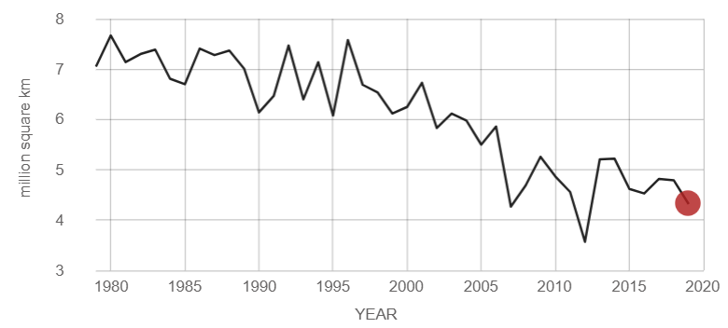

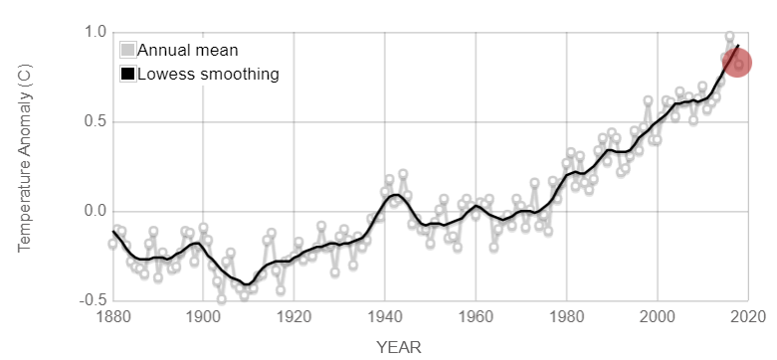

Slide 16
